Slide 1
Human pluripotent stem cell-derived organoids as a model of intestinal xenobiotic metabolism
Kengo Sasaki^{a,b}, Makoto Inoue^{c}, Masakazu Machida^{d}, Tomoyuki Kawasaki^{d}, Satoru Tsuruta^{d,e}, Hajime Uchidaª, Seisuke Sakamotoª, Mureo Kasaharaª, Akihiro Umezawa^{d}, Hidenori Akutsu^{d}*
ªTransplantation Centre, National Centre for Child Health and Development, Tokyo, Japan
^{b}Department of Surgery, Tohoku University, Sendai, Japan
^{c}Life Science Laboratory, Dai Nippon Printing Co., Tokyo, Japan
^{d}Centre for Regenerative Medicine, National Research Institute for Child Health and Development, Tokyo, Japan
^{e}Department of Gastroenterological Surgery, Hirosaki University Graduate School of Medicine, Hirosaki, Japan
*Correspondence:
H Akutsu, Department of Reproductive Medicine, Center for Regenerative Medicine, National Center for Child Health and Development (NCCHD), Okura 2-10-1, Setagaya-ku, Tokyo, 157-8535, Japan

Slide 2
Supplementary Table 1
Supplementary Table 1. List of primers used for quantitative RT-PCR
Gene | Forward primer (5′→3′) | Reverse primer (3′→5′)
ABCB1 | AAGGCCTAATGCCGAACACA | GTCTGGCCCTTCTTCACCTC
CYP3A4 | CTGTGTGTTTCCAAGAGAAGTTAC | TGCATCAATTTCCTCCTGCAG
GAPDH | GCTCAGACACCATGGGGAAGGT | GTGGTGCAGGAGGCATTGCTGA

Slide 3
Supplementary Figure 1
(a)
(b)
MUC2/CDX2/DAPI
E-CAD/CHGA/DAPI
(c)
Ezrin
XF-HIO
Supplementary Figure 1. (a) and (b) The efficiency for intestinal epithelium layers in Xenogeneic-free human intestinal organoids (XF-HIOs) was quantified (n=4,5 different organoids) by counting for caudal type homeobox 2 (CDX2) positive or Chromogranin A (CHGA) positive cells. (a) Immunostaining for CDX2, Mucin2 (MUC2), E-cadherin (E-CAD) and CGA in XF-HIOs. Cell nuclei were counterstained with 4′,6-diamidino-2-phenylindole, dihydrochloride (DAPI). Scale bars = 50 μm. (b) Either CDX2 (gray) or CHGA (black) positivity were 95.3% (n=5 different organoids) or 10.6% (n=4 different organoids), respectively. Data are reported as means ± SD. (c) Immunohistochemical staining for Ezrin positively localized to a apical part of the epithelial layers in the XF-HIOs. Scale bar = 100 μm.

Slide 4
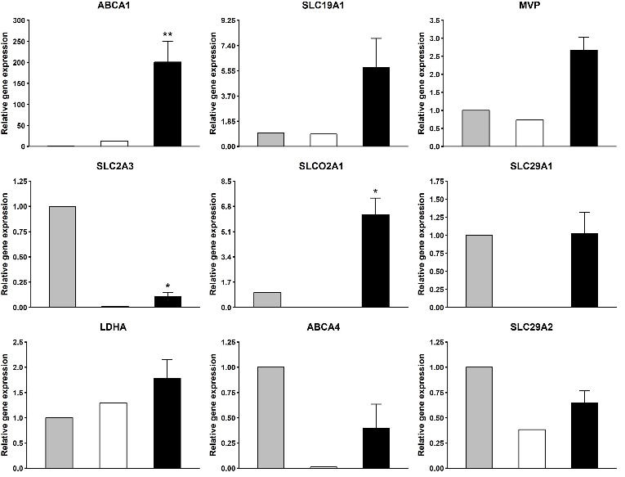
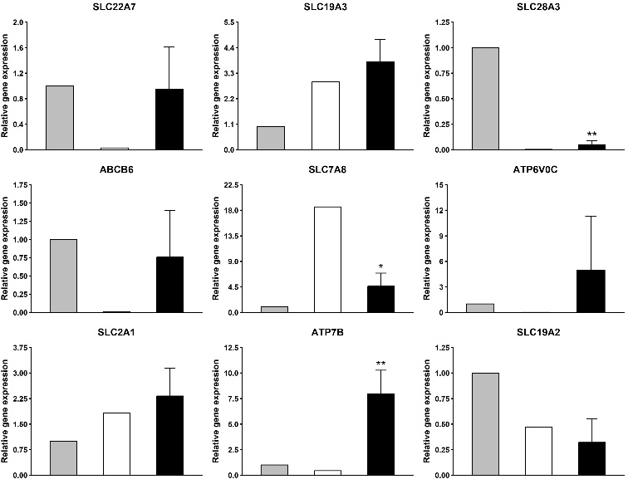
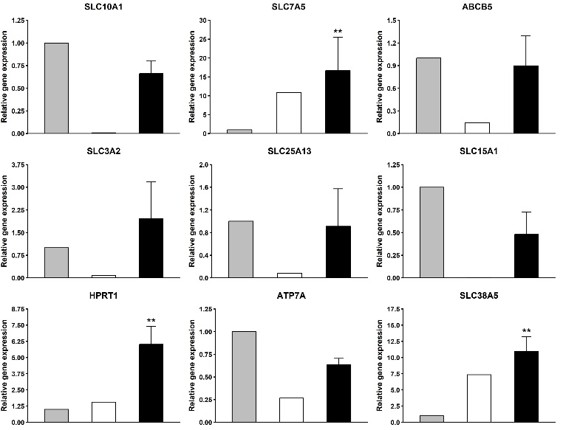
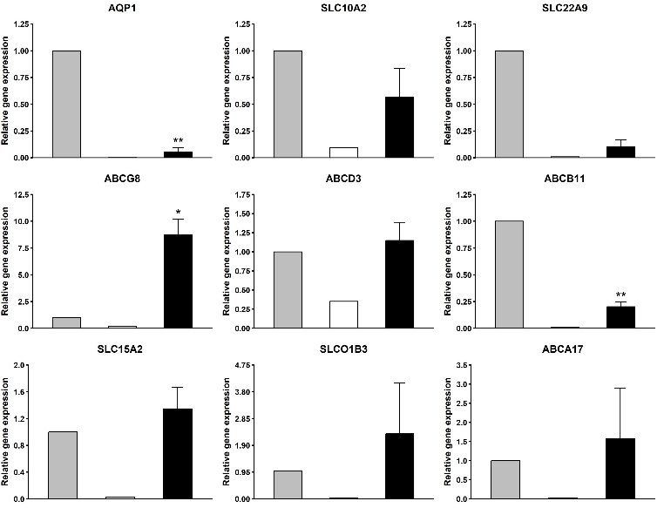
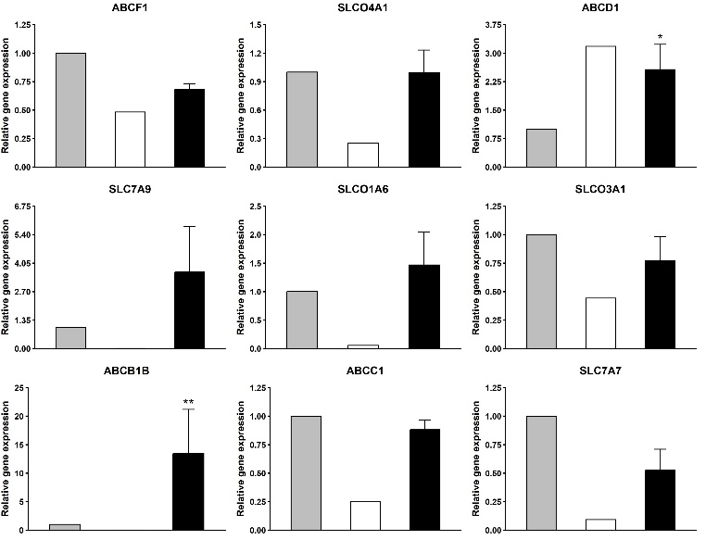
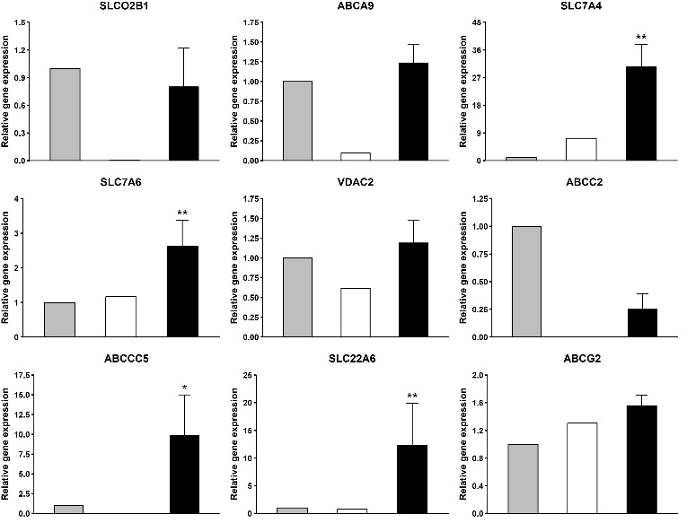
Supplementary Figure 2
Intestine
ES cells
XF-HIO
Intestine
ES cells
XF-HIO
Intestine
ES cells
XF-HIO
Intestine
ES cells
XF-HIO
Intestine
ES cells
XF-HIO
Intestine
ES cells
XF-HIO

Slide 5
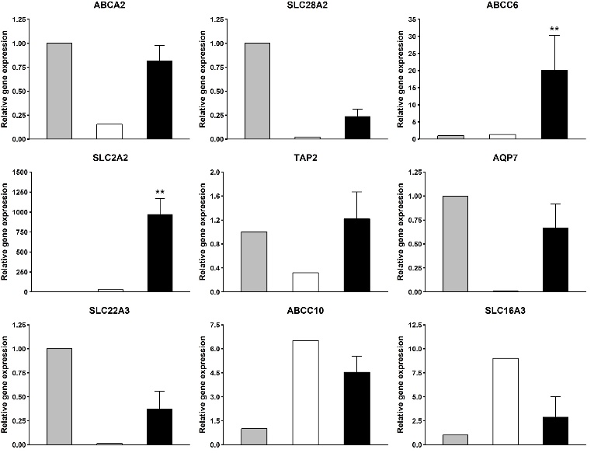
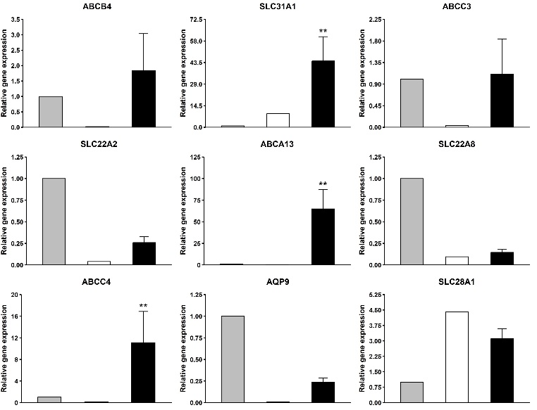
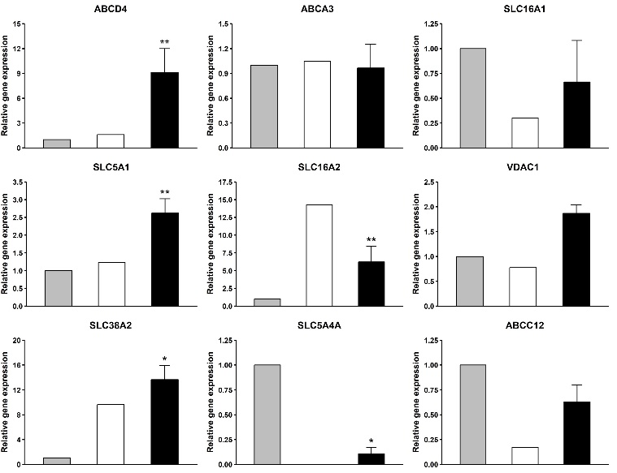
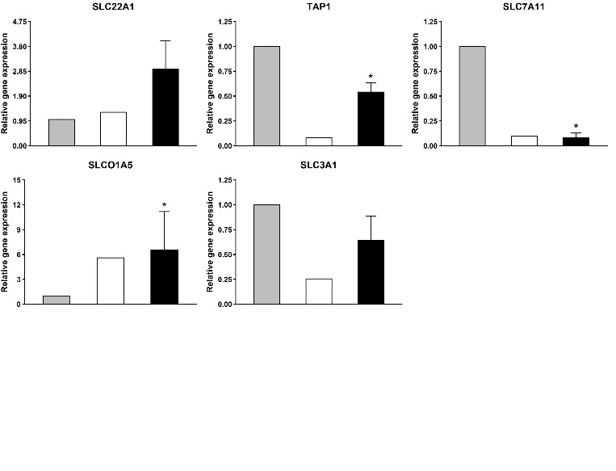
Supplementary Figure 2
Intestine
ES cells
XF-HIO
Intestine
ES cells
XF-HIO
Intestine
ES cells
XF-HIO
Intestine
ES cells
XF-HIO
Intestine
ES cells
XF-HIO
Intestine
ES cells
XF-HIO
Supplementary Figure 2. Gene expression of drug transporters in XF-HIOs. The relative gene expressions in a single of the XF-HIOs are represented by black bars, whereas those of the controls (adult intestines and ES cells) are in gray and in white bars, respectively. Values were normalized against GAPDH. Data are reported as means ± SE. Statistical significance were identified using Student’s t-test (*p < 0.05, **p < 0.01; n = 5).

Slide 6
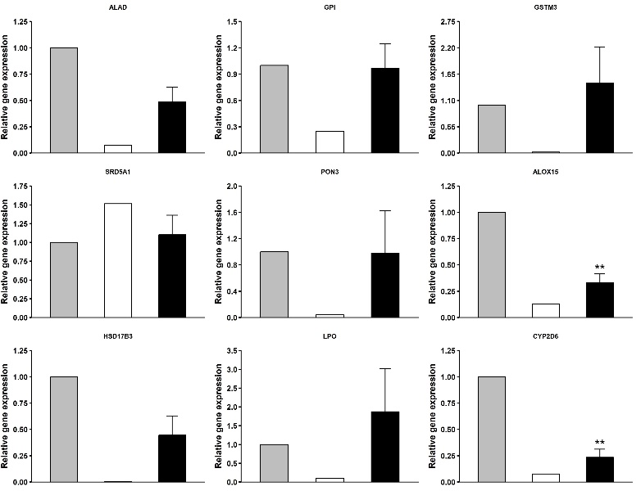
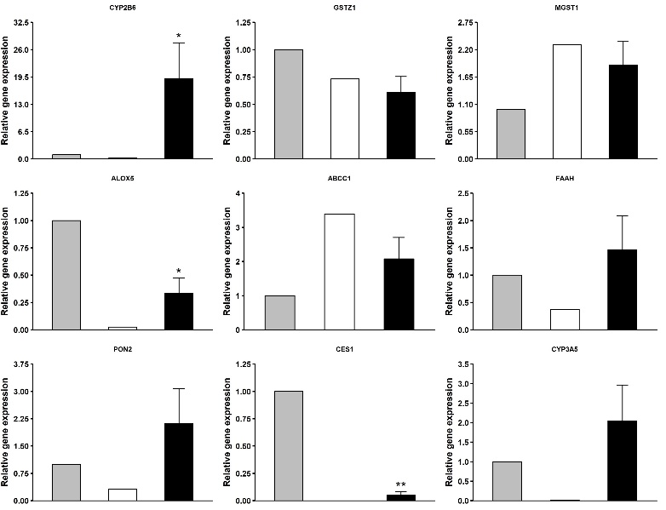
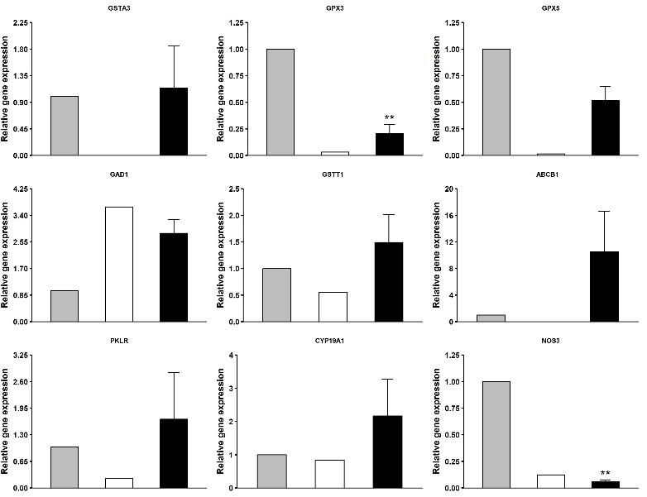
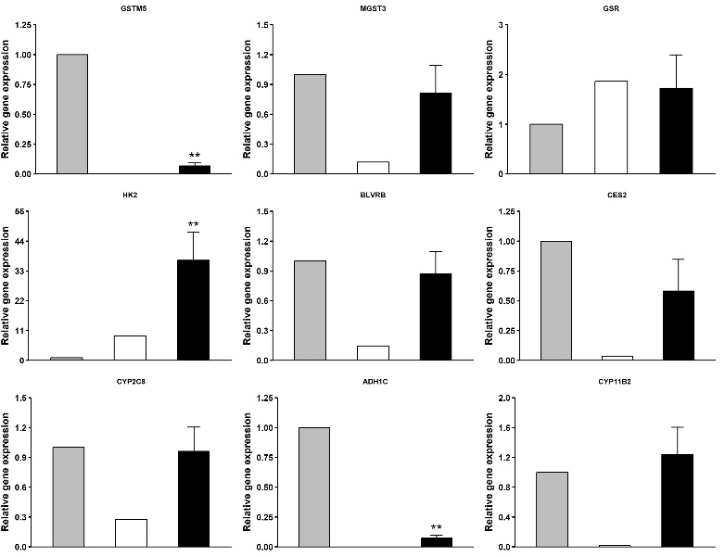
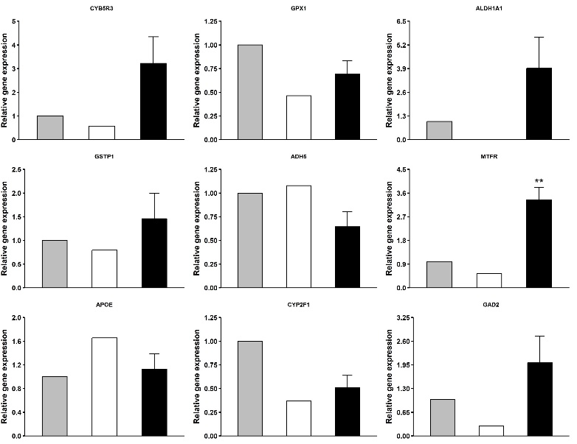
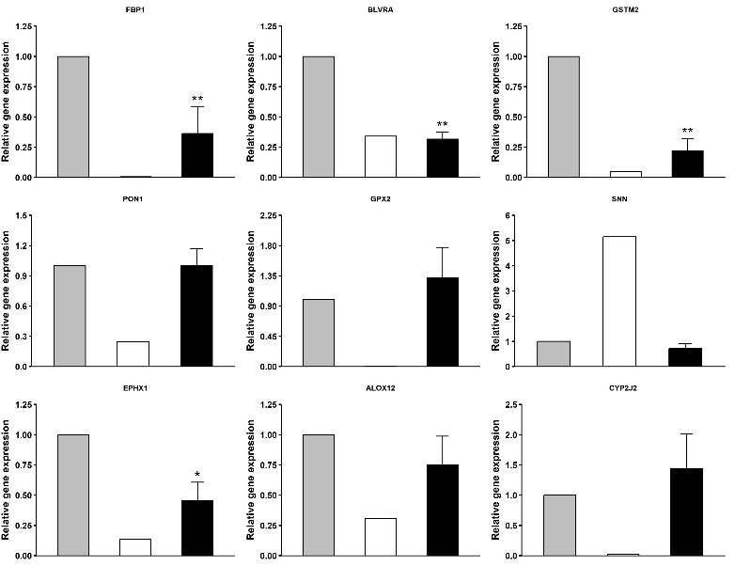
Supplementary Figure 3

Slide 7
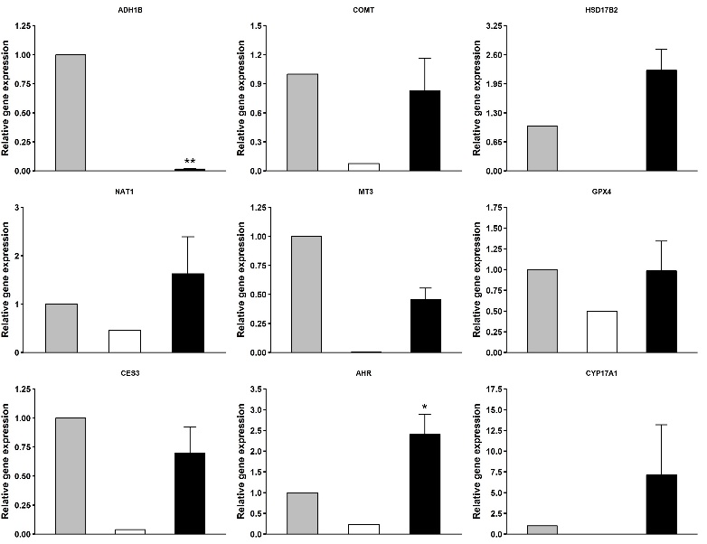
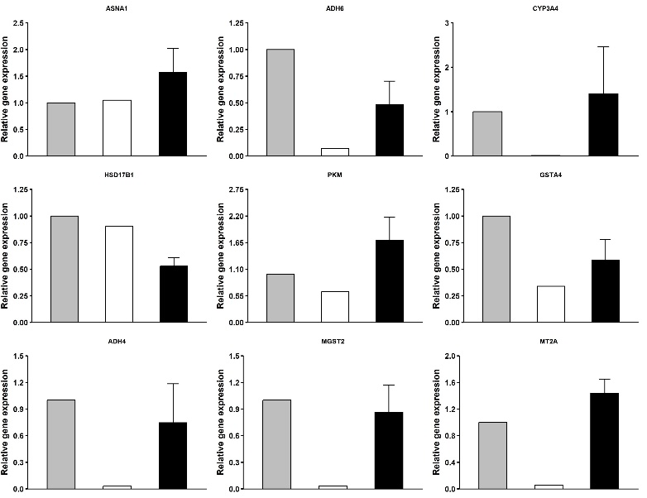
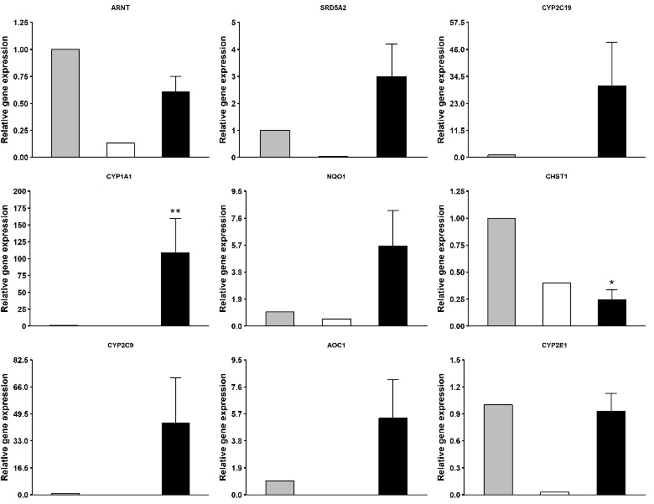
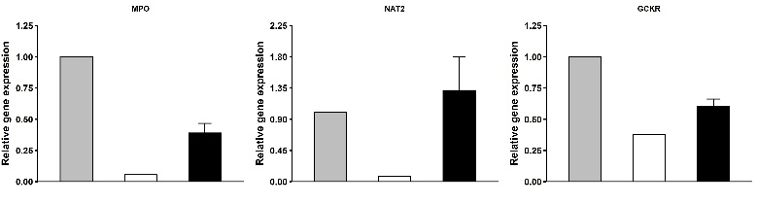
Supplementary Figure 3
Intestine
ES cells
XF-HIO
Intestine
ES cells
XF-HIO
Intestine
ES cells
XF-HIO
Intestine
ES cells
XF-HIO
Intestine
ES cells
XF-HIO
Intestine
ES cells
XF-HIO
Supplementary Figure 3. Gene expression of metabolizing enzymes in XF-HIOs. The relative gene expressions in a single of the XF-HIOs are represented by black bars, whereas those of the controls (adult intestines and ES cells ) are in gray and in white bars, respectively. Values were normalized against GAPDH. Data are reported as means ± SE. Statistical significance were identified using Student’s t-test (*p < 0.05, **p < 0.01; n = 5).

Slide 8
Supplementary Figure 4
CES1
CES2
Human small intestine
Supplementary Figure 4. Human small intestine showed strong staining for CES2,whereas it exhibited very weak staining for CES1.

Slide 9
Supplementary Figure 5
Isotype Rabbit IgG antibody
Isotype Mouse IgG2a antibody
Human small intestine
Supplementary Figure 5. Isotype control staining of human intestine.

