Slide 1
A
Ratio of S4 Synaptosomal total tau
Entorhinal Cortex
B
Ratio of P4 Synaptosomal total tau
C
Ratio of S4 Synaptosomal total tau
Middle Frontal Cortex
D
Ratio of P4 Synaptosomal total tau
Notes:
Supplementary Figure 1. Ratios of each synaptosomal fraction total tau level to total synaptosomal total tau level across clinical and neuropathologic AD designations Comparison of the ratio of total tau in synaptosomal fractions across clinical, NIA-AA AD Neuropathologic Change, and Braak neurofibrillary tangle stage designations. aMCI, amnestic mild cognitive impairment; AD, Alzheimer’s disease dementia. A) Ratio of synaptosomal total tau in entorhinal cortex S4 fractions to total synaptosomal (S4+P4) total tau. B) Ratio of synaptosomal total tau in entorhinal cortex P4 fractions to total synaptosomal (S4+P4) total tau. C) Ratio of synaptosomal total tau in middle frontal S4 fractions to total synaptosomal (S4+P4) total tau. D) Ratio of synaptosomal total tau in middle frontal P4 fractions to total synaptosomal (S4+P4) total tau. Median total tau ratios were calculated with 95% confidence intervals and Spearman’s Rank correlation was performed by each designation.

Slide 2
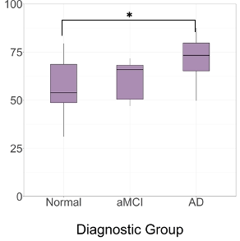
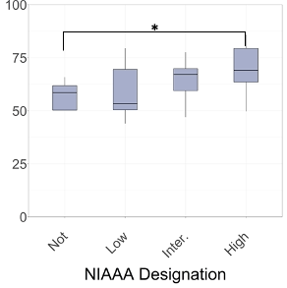
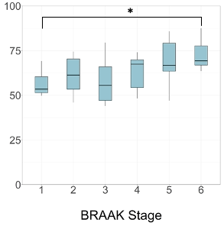
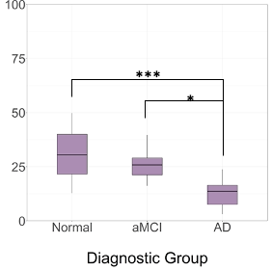
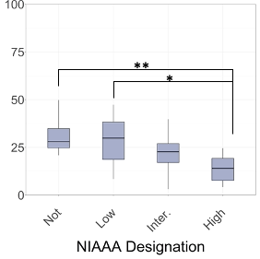
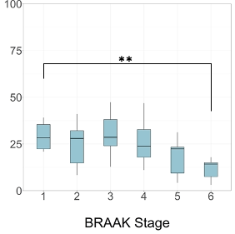
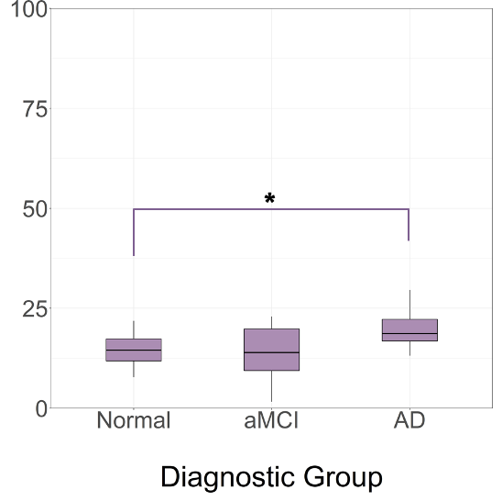
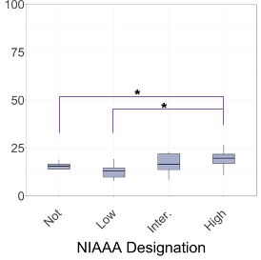
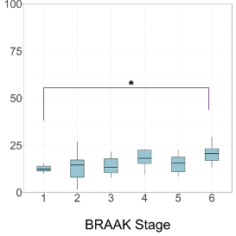
A
Percent of Entorhinal
S2 pTau231
B
Percent of Entorhinal
S4 pTau231
C
Percent of Middle Frontal
P4 pTau231
Notes:
Supplementary Figure 2. Percentage of pTau231 in S2, S4, and P4 fractions across clinical and neuropathologic AD designations. A) Shown is the percentage of total pTau321 detected in the entorhinal S2 fraction across clinical diagnostic groups, NIA-AA AD Neuropathologic Change designations, and Braak neurofibrillary tangle stages in the entorhinal cortex. aMCI, amnestic mild cognitive impairment; AD, Alzheimer’s disease dementia. Unpaired t-tests, n.s., not significant, *p < 0.05, **p < 0.01, and ***p < 0.001. B) Shown is the percentage of pTau231 in entorhinal S4 fractions across clinical diagnostic groups, NIA-AA AD Neuropathologic Change designations, and Braak neurofibrillary tangle stages. C) Shown is the percentage of pTau231 in middle frontal P4 fractions across clinical diagnostic groups, NIA-AA AD Neuropathologic Change designations, and Braak neurofibrillary tangle stages. Spearman’s Rank correlation was performed by each designation, n.s., not significant, *p < 0.05, **p < 0.01, and ***p < 0.001. Box plots indicated median and interquartile range (IQR) of the percent in each fraction.

Slide 3
A
B
C
D
E
F
Notes:
Supplementary Figure 3.

Slide 4
Notes:
Supplementary Figure 4.

Slide 5
Supplementary Table 1. Buffers Used for Synaptosomal Fraction Protocol
250 mL Sucrose buffer pH 7.4: | 250 mL HBS buffer pH 7.4: | *10 mL 50% Triton X-100:
27.384 g sucrose (0.32 M) | 1.489 g HEPES (25 mM) | 5 mL H20
1.489 g HEPES (25 mM) | 2.192 g NaCl (150 mM) | 5 mL Triton X-100

Slide 6
Supplementary Table 2 Inhibitors Used for Synaptosomal Fractionation Protocol
Note: add inhibitors to buffers within 1 h of use
Per 1 mL buffer (Sucrose, HBS and PBS), add:
1 µL | Protease inhibitor cocktail (Sigma P8340)
1 µL | Protease inhibitor cocktail 2 (Sigma P5726)
1 µL | Phosphatase inhibitor A (ChemCruz sc-45044)
1 µL | 100 mM PMSF
1 µL | 100 mM 1,10-Phenanthroline monohydrate

Slide 7
Supplementary Table 3 Antibody Characteristics
Description of antibodies used in this study. Legend: Poly = polyclonal; Mono = monoclonal
Target | Clone | Raised in | Poly versus Mono | Company | Dilution | Application
Beta-actin |  | Rabbit | Mono | LI-COR | 1:1000 | Immunoblot
GAPDH |  | Rabbit | Mono | LI-COR | 1:1000 | Immunoblot
Synaptophysin | SY38 | Mouse | Mono | abcam | 1:500 | Immunoblot
PSD-95 | K28/43 | Mouse | Mono | Antibodies Inc. | 1:1000 | Immunoblot and immunohistochemistry
AMPA GluR1 | EPR19522 | Rabbit | Mono | Abcam | 1:200 | Immunohistochemistry
pTau231 & Total Tau | Proprietary |  |  | Quanterix | Kit | Simoa HD-1 ELISA
pTau214 | EPR1884 | Rabbit | Mono | AbCam |  | Immunohisochemistry

