Slide 1
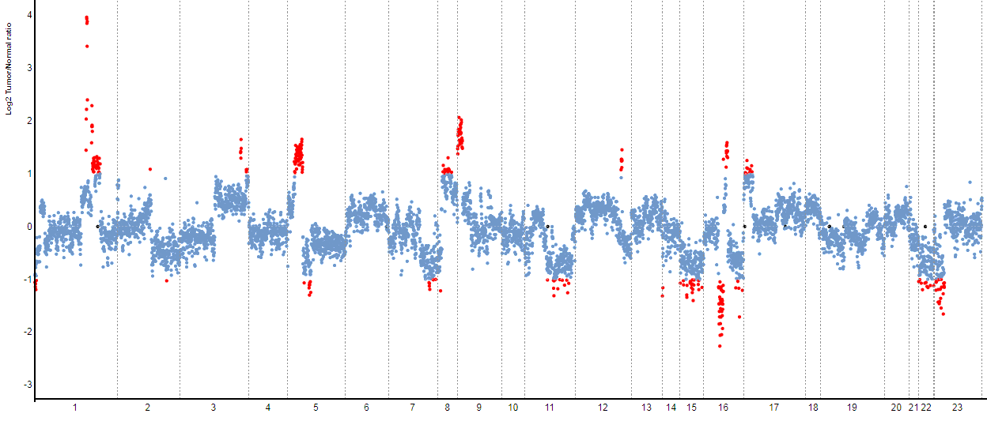
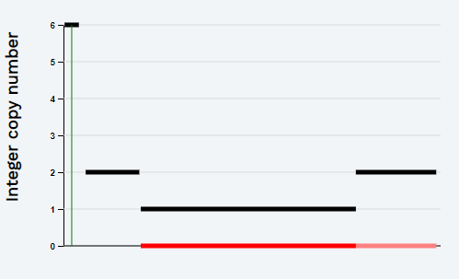
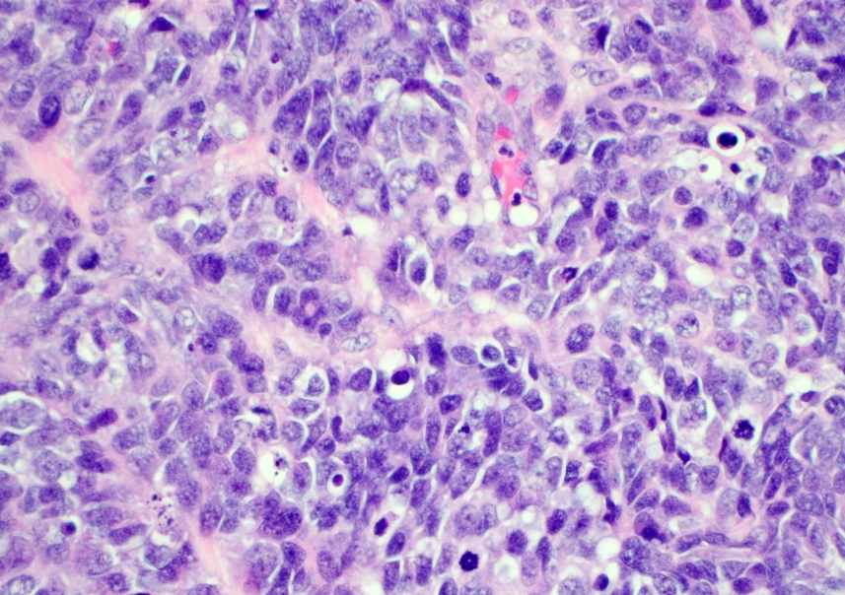
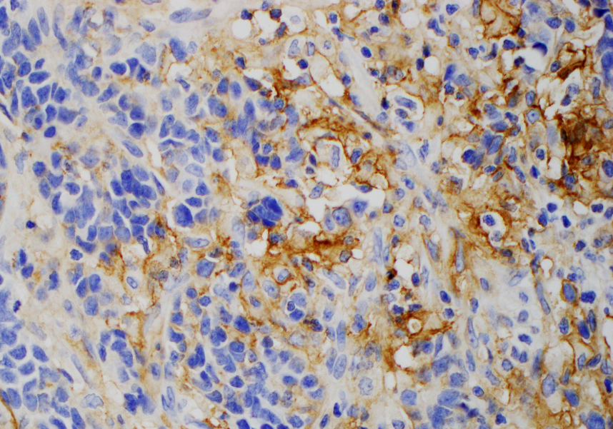
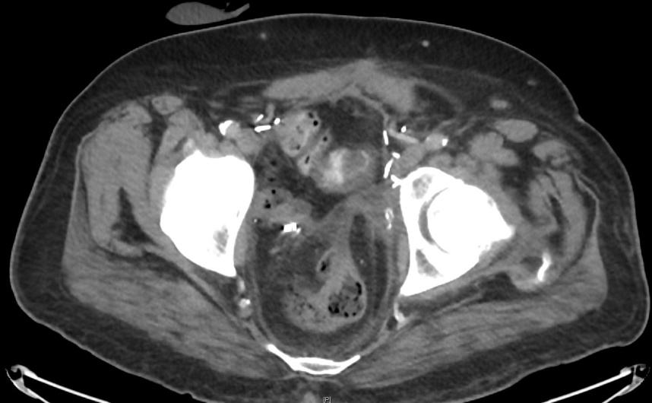
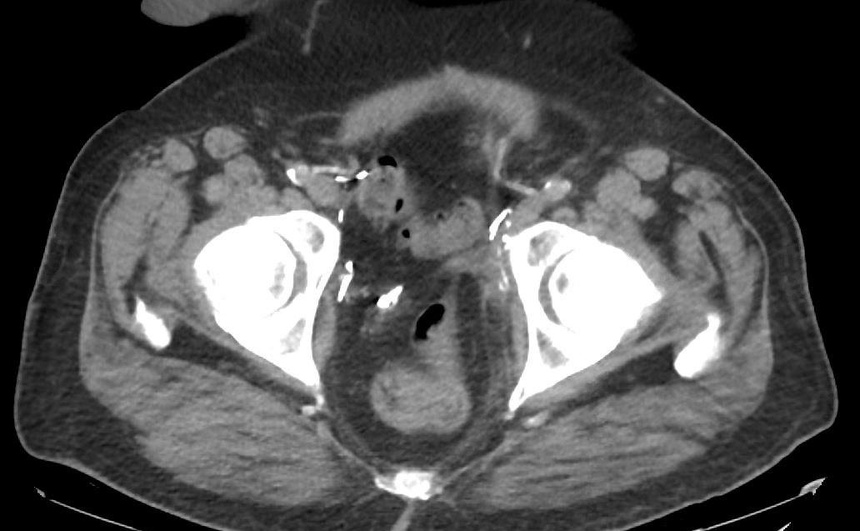
A
3.4 Fold Change (JAK2/PD-L1)
Log2 Tumor/Normal Ratio (Amplifications in Red)
1
2
8
10
15
23
11
12
16
17
18
19
3
4
5
6
7
9
13
20
B
C
PD-L1
D
E
Pre-Atezolizumab (Day 0)
Post-Atezolizumab (Day 1589)
Supplementary Figure 2: Copy Number Assessment, Histopathology & Imaging. A copy number plot (A, Case 1) with relative (Log2) tumor/normal ratios (y-axis) and corresponding chromosomes (x-axis) is displayed, with each blue dot representing an individual probe region. Amplified regions are shown in red and the inset shows a 6-fold gain based on the FACETS algorithm (chromosome 9, arrow indicates 9p24.1 amplicon). Representative histopathology (B) and PD-L1 IHC (C) is shown. Baseline CT imaging for this patient (Case 1) prior to initiation of immunotherapy (D) and at 1589 days of follow up (E) representing stable pelvic disease is shown.

