Slide 1
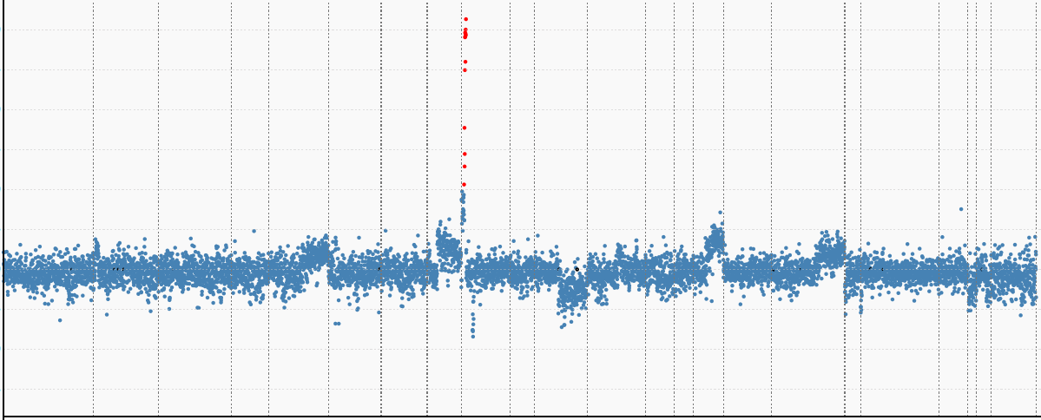
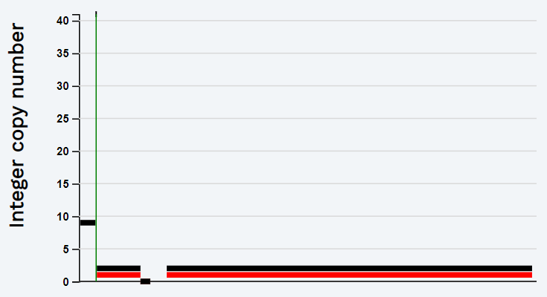
A
5.8 Fold Change (PD-L1)
Log2 Tumor/Normal Ratio (Amplifications in Red)
1
2
8
10
15
23
11
12
16
17
18
19
3
4
6
7
9
13
20
5
B
C
Red: PD-L1; Brown: PAX8
PD-L1
Supplementary Figure 3: Copy Number Assessment and Histopathology. A copy number plot (A, Case 7, primary tumor: poorly differentiated carcinoma with clear cell adenocarcinoma features) with relative (Log2) tumor/normal ratios (y-axis) and chromosomes (x-axis) is displayed, with each blue dot representing an individual probe region. Amplified regions are shown in red and the inset shows a 41-fold gain based on the FACETS algorithm (chromosome 9, arrow indicates CD274 gene locus). Representative histopathology (B) and PD-L1 IHC (C) is shown for the corresponding metastatic lymph node. The inset in C shows dual labeling for PAX8 (brown, nuclear) and PD-L1 (red, membranous).

